Slide 1
CARES FOR THE ENVIRONMENT Social Media Strategy
Here is where your presentation begins

Slide 2
Contents of this template
You can delete this slide when you’re done editing the presentation
Fonts | To view this template correctly in PowerPoint, download and install the fonts we used
Used and alternative resources | An assortment of graphic resources that are suitable for use in this presentation
Thanks slide | You must keep it so that proper credits for our design are given
Colors | All the colors used in this presentation
Icons and infographic resources | These can be used in the template, and their size and color can be edited
Editable presentation theme | You can edit the master slides easily. For more info, click here
For more info: SLIDESGO | BLOG | FAQs
You can visit our sister projects: FREEPIK | FLATICON | STORYSET | WEPIK | VIDEVO

Slide 3
Table of contents
01
02
03
04
05
06
Planning
Content creation
Review & editing
Scheduling
Format and design
Final review

Slide 4
What is social media?
Overall, social media is a versatile tool that can enrich your life, facilitate connections, and offer a window into the broader world. It's a platform where you can learn, share, and engage in meaningful ways, enhancing both your online and offline experiences. Here you have some purposes of social media:
Personal connections: Connect with others, share moments, and express yourself
Information and entertainment: Stay informed, discover diverse content, and enjoy entertainment
Learning and social impact: Learn, contribute to causes, and engage in diverse communities

Slide 5
01
Planning

Slide 6
Planning
Objectives and audience
Begin by outlining your objectives, whether it's sharing personal moments, promoting a cause, or growing your online presence. Consider who your audience is, whether they're followers, supporters, or friends, and understand their interests to tailor your content
Your message
Select a theme and tone that resonate with your audience, whether it's your Instagram followers, environmental enthusiasts, or friends. Create engaging content, like images, videos, or text, that aligns with your goals and speaks to the preferences of your target audience

Slide 7
Content creation
Quality
Produce high-quality content for individuals, organizations, or causes. Mix images, videos, and captions to keep it engaging and dynamic. Showcase personal experiences or organizational impact
Platforms
Tailor content to each platform's characteristics and user expectations. Adapt visuals and messages to the platform's nuances for better resonance
Captions
Enhance content with concise, engaging captions. Share stories that resonate with your audience. For causes, emphasize your mission. Utilize relevant hashtags to amplify reach

Slide 8
Review and editing
Accuracy check
Grammar and spelling
Before sharing, review your content for accuracy. Whether you're an individual sharing personal stories or an environmental organization spreading awareness, ensure details are correct
Proofread for grammar and spelling errors. Even personal accounts benefit from error-free content. For organizations or causes, polished content boosts professionalism and credibility
Clarity and consistency
Visual appeal
Edit for clarity and consistency. Whether it's your personal experiences or your organization's initiatives, ensure your message is easy to understand. Use a consistent tone that aligns with your content's purpose
Check visuals for quality. Ensure images and videos are clear and visually appealing. Strong visuals enhance your content's impact and engagement

Slide 9
Scheduling
Optimal timing
Platforms insights
Consistency
For individuals, consider when your audience is most active. Organizations promoting causes should align posts with peak engagement times
Study platform analytics. Know when your content gets the most attention. Post accordingly for
maximum impact
Maintain a consistent posting schedule. For personal accounts, regular updates keep followers engaged. Consistency builds trust
Varied timing
Time zones
Content type
Experiment with posting times. Test different slots and observe engagement patterns. Adapt your schedule based on results
Consider your audience's time zones. Schedule posts to reach them when they're most likely to be online
Match post types with optimal times. Share longer content when your audience is more receptive. Use short posts when attention spans are limited

Slide 10
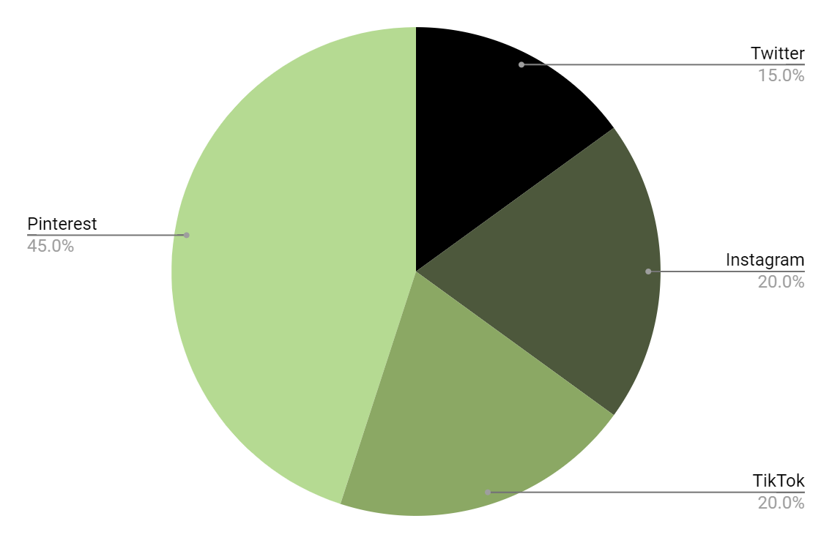
Engagement share
15%
Twitter
20%
Instagram
20%
TikTok
45%
Pinterest
Follow the link in the graph to modify its data and then paste the new one here. For more info, click here

Slide 11
A table for your schedules
 | Monday | Tuesday | Wednesday | Thursday | Friday
TikTok | Idea | Idea | Idea | Idea | Idea
Instagram | Idea | Idea | - | Idea | Idea
Twitter | Idea | Idea | Idea | Idea | -
Pinterest | Idea | Idea | Idea | - | Idea
Email | - | Idea | - | Idea | Idea
Facebook | Idea | - | Idea | Idea | -

Slide 12

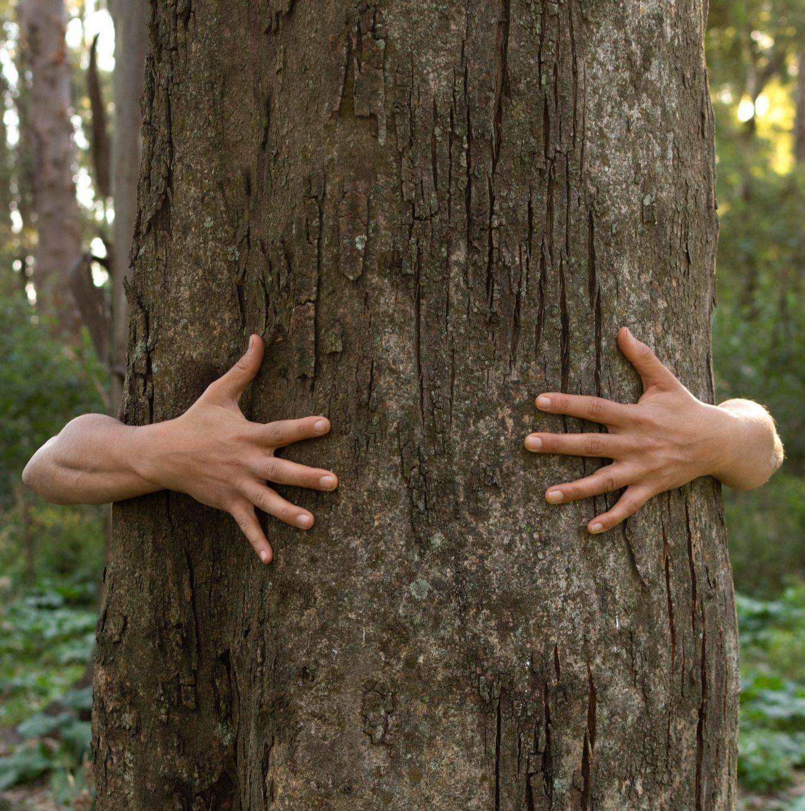
This is what your page will look like
01
Your username
Remember that web pages must be optimized to work on phones, since 80% of people only visit websites from their smartphones
Your username should be the first thing they see
Select your best photo for the front page
Use creative captions for your posts!
02
03

Slide 13
Buyer persona or target audience
Background
Motivations
Emily is an environmentally-aware individual or represents an organization dedicated to sustainable practices. She may work for an eco-friendly brand.
01
Planet Earth
02
SM platforms
Emily Jackson
Key characteristics
Passionate about the Environment: Emily is deeply committed to environmental causes
Tech-Savvy: Emily is well-versed in social media platforms/digital tools
Creative: She is innovative to related to environmental sustainability
Data-Driven: Analyzing SM data and using it to refine her strategies
03
Create content
Age | 35 years old
Education | Business
Occupation | Manager
Location | Urban areas
Income | 2k annually
Pain points
Limited resources: She haven’t a large budget or dedicated SM team
Content authenticity: Balancing the authenticity with engaging content

Slide 14
Roadmap infographic of our socials
Initiative | Objective | Jan | Feb | Mar | Apr | May | Jun | Jul | Aug | Sep | Oct | Nov | Dec
Initiative 01 | In this section, describe the objective of your initiative
Initiative 02 | In this section, describe the objective of your initiative
Initiative 03 | In this section, describe the objective of your initiative
Initiative 04 | In this section, describe the objective of your initiative
Initiative 05 | In this section, describe the objective of your initiative
Initiative 06 | In this section, describe the objective of your initiative

Slide 15
Showcase some pictures!
You know what they say: a picture is worth a thousand words — use them!

Slide 16
Testimonials
"I was amazed by how this strategy reshaped my social media game — it's like I found the missing puzzle piece for audience engagement!"
—Laura Patterson
"Before discovering these techniques, I underestimated the power of social media. Now, I'm witnessing real results and meaningful connections"
—John Nelson
“My social media presence took a remarkable turn after following this advice. The growth in interactions and followers speaks for itself”
—Fatima James

Slide 17
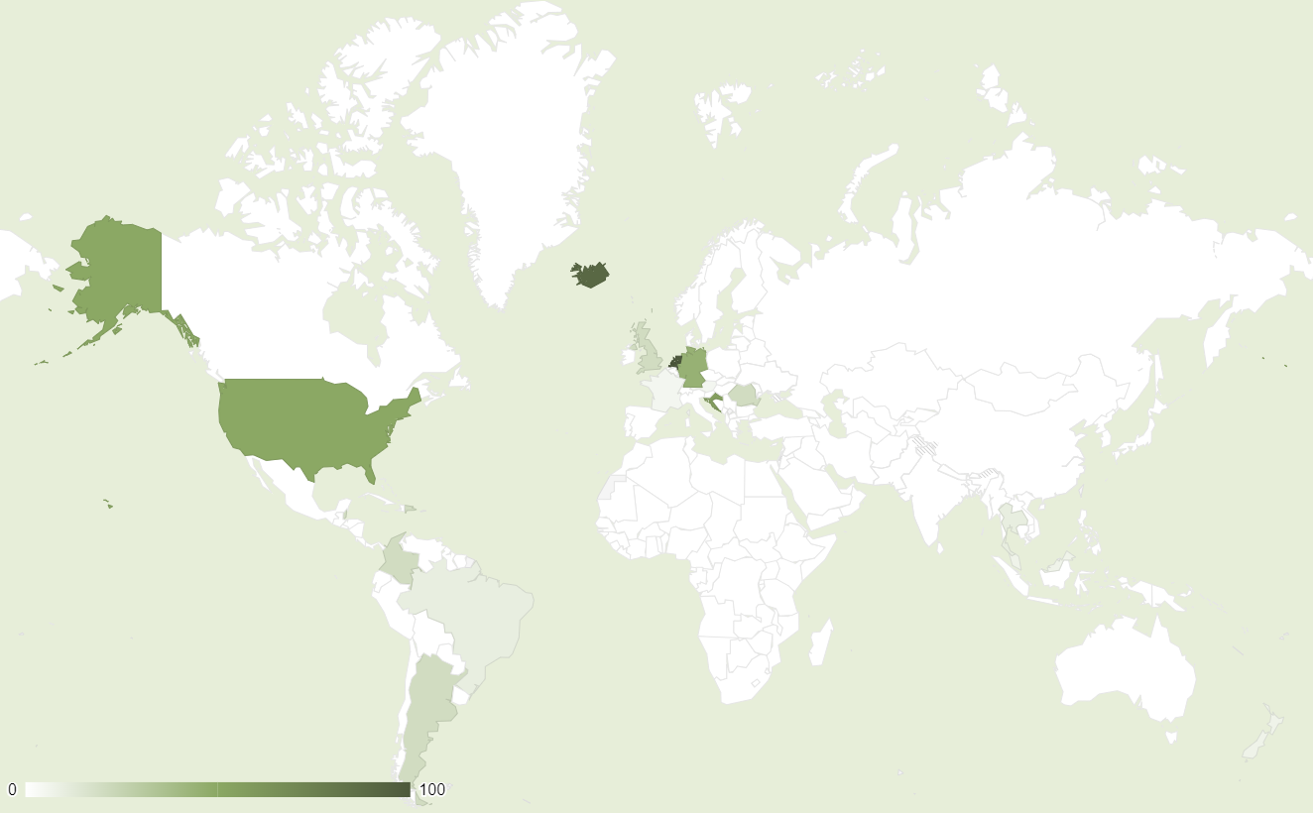
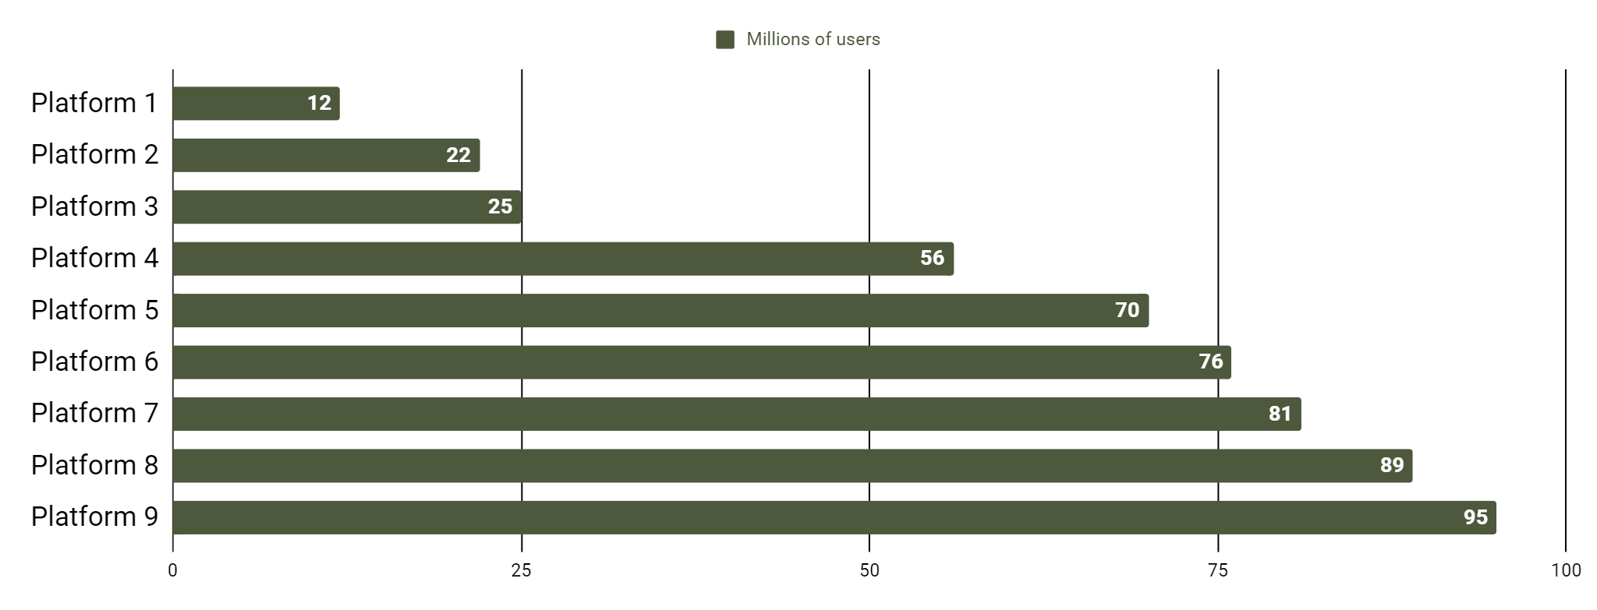
Social media analytics
Worldwide reach
xxx billion
xh xmin
xx
Users worldwide
Average
time spent
Platforms used
Platforms with most users
xxx billion
xxx billion
Country 1 users
Country 2 users
Follow the link in the graph to modify its data and then paste the new one here. For more info, click here

Slide 18
Thanks
Does anyone have any questions?
addyouremail@freepik.com
+91 620 421 838
yourwebsite.com
Please keep this slide for attribution

